Slide 1


Bell Work
Find the $g^{′}\left(x\right) given g\left(x\right)$
$$g\left(x\right)={4x}^{2}−12x+20$$

Slide 2
Pre-calc trig
Day 73

Slide 3
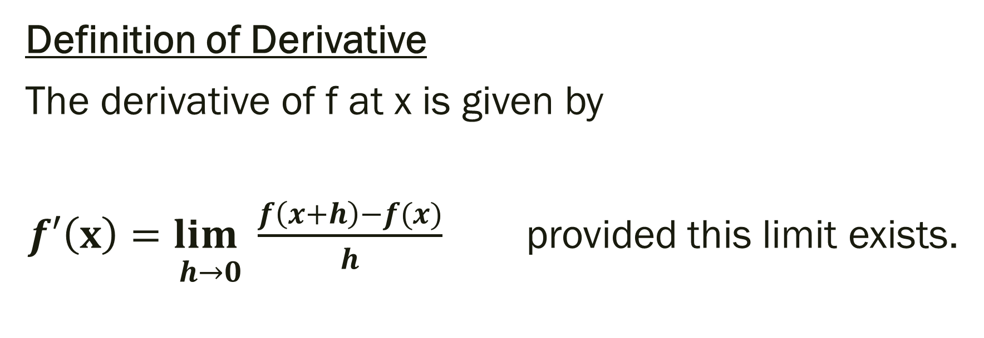
12.3 The Tangent Line Problem (From last time…)
Definition of Derivative
The derivative of f at x is given by
$\underset{ h→0}{f′\left(x\right)=lim}{\frac{f\left(x+h\right)−f(x)}{h}}$ provided this limit exists.

Slide 4
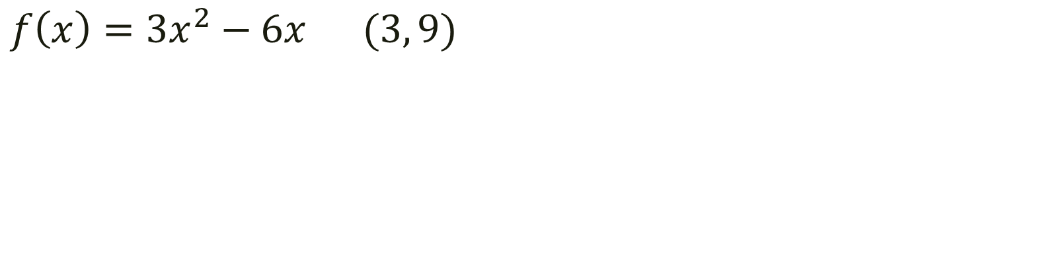
Example: Find the derivative and use it to identify the slope of the tangent through the given point. (Use the alternative way we learned today)
$$f\left(x\right)={3x}^{2}−6x (3, 9)$$

Slide 5
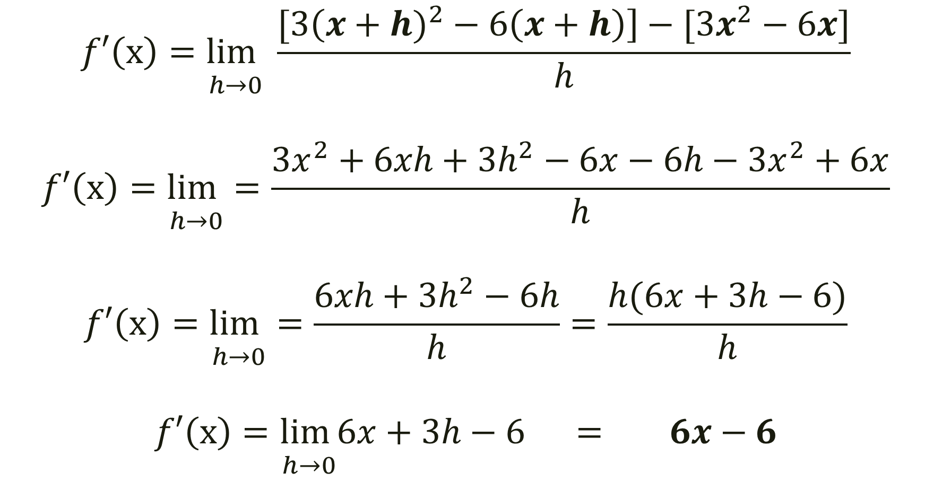
$$f\left(x\right)={3x}^{2}−6x (2, 0)$$
$$\underset{ h→0}{f′\left(x\right)=lim}{\frac{[3\left(x+h)^{2}−6\left(x+h\right)\right]−[3x^{2}−6x]}{h}}$$
$$\underset{ h→0}{f′\left(x\right)=lim}=\frac{3x^{2}+6xh+3h^{2}−6x−6h−3x^{2}+6x}{h}$$
$$\underset{ h→0}{f′\left(x\right)=lim}=\frac{6xh+3h^{2}−6h}{h}=\frac{h(6x+3h−6)}{h}$$
$$\underset{ h→0}{f′\left(x\right)=lim}6x+3h−6 = 6x−6$$

Slide 6
Solution
Since the derivative is 6x-6…
Therefore the slope of the tangent through (3,9) is at f’(3)=6(3) – 6 …
f’(3) = 12
Graph to see.

Slide 7
Could we find the equation of the line (not just the slope) through the point (3,9)?
What if we wanted to find the slope through the point (2,0)?

Slide 8
Another way to find the derivative…
For each term, multiply the exponent of each variable with it’s coefficient (creating a new coefficient) and subtract one from the given exponent

Slide 9
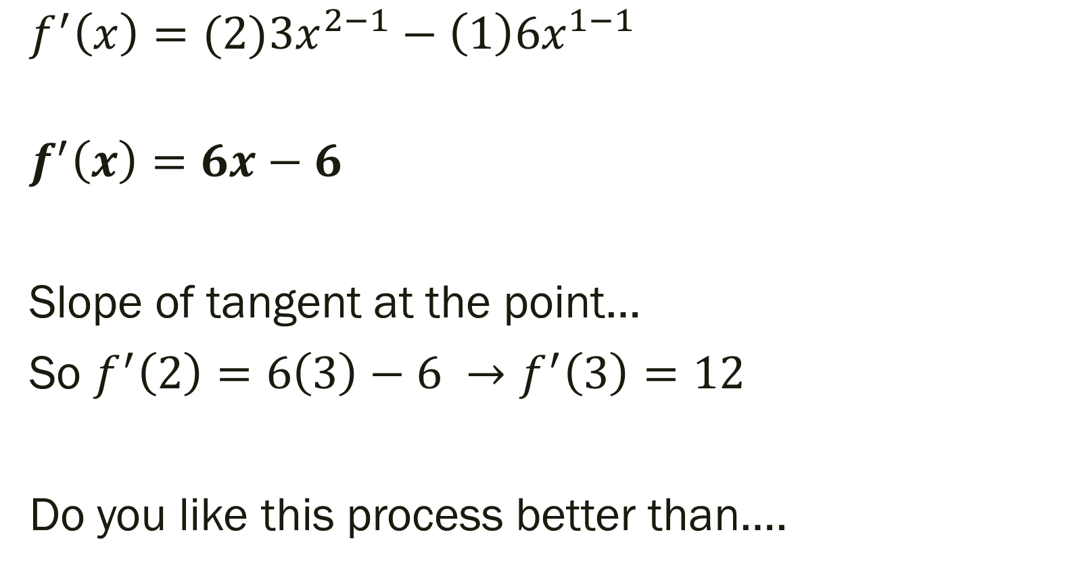
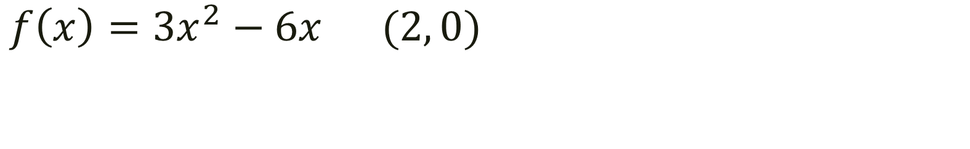
$$f\left(x\right)={3x}^{2}−6x (2, 0)$$
$${f^{′}\left(x\right)=(2)3x}^{2−1}−\left(1\right)6x^{1−1}$$
$$f^{′}\left(x\right)=6x−6$$
Slope of tangent at the point…
So $f^{′}\left(2\right)=6\left(3\right)−6 →f^{′}\left(3\right)=12$
Do you like this process better than….

Slide 10
From last time…
Page 868 #5, 7, 9, 11, 49
Page 878 #5, 6, 9, 10

Slide 11
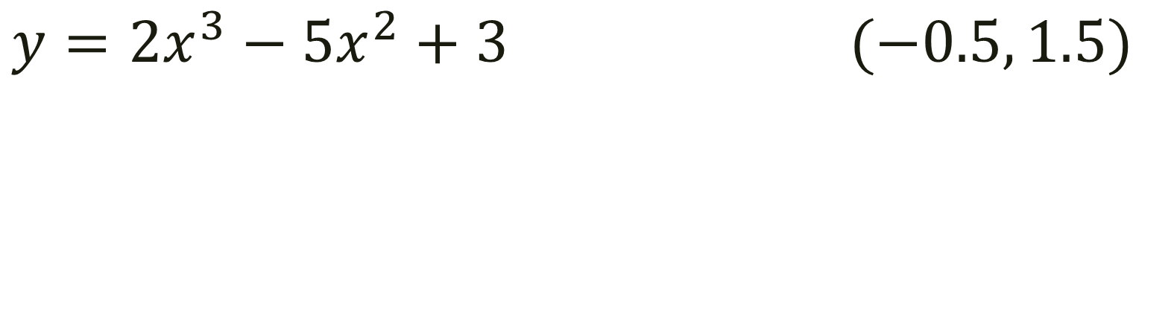
Another Example: Find Derivative. Find the slope of the tangent at the given point. Write the equation of the line through the given point.
$$y={2x}^{3}−{5x}^{2}+3 (−0.5, 1.5)$$

Slide 12
For next time…
Page 878 #8, 43, 46, 59, 62, 71

